Slide 1

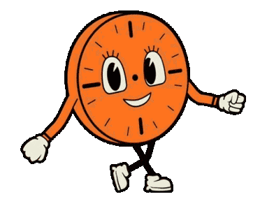
Mini Project Presentation
By- Sameed Ahmed
USN: 2VX22CB043

Slide 2
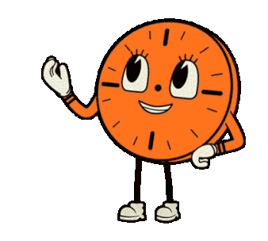
Project Abstract and Problem Statement:
Reducing paper waste and Electricity consumption with the help of E-Paper Displays and Banners in public spaces
Problem Statement:
The growing number of digital displays and billboards, along with adverts in the form of flyers and posters have resulted in lots of paper wastage as well as greater electricity
consumption, especially in densely populated regions, most notably public hotspots like bus stands and stations.

Slide 3
E-Paper
E-Paper displays and posters can be used to replace such displays and posters, as they provide for a more environmentally friendly alternative, as they help reduce electricity consumption by over 90% as compared to traditional digital displays.
The principle behind e-paper displays is that they contain millions of microscopic 'ink' particles, which move up and down int the background of the display due to electrical stimulation, accordingly, creating darker and lighter regions on the screen, thus displaying text or image. Furthermore, these displays do not need to refresh constantly, once an image has been set, it will stay the same even if power is cut off from the display, until the next time it is refreshed.
These E-Paper displays are reusable and can also be re-purposed into other appliances at the end of their useful lifetime.

Slide 4
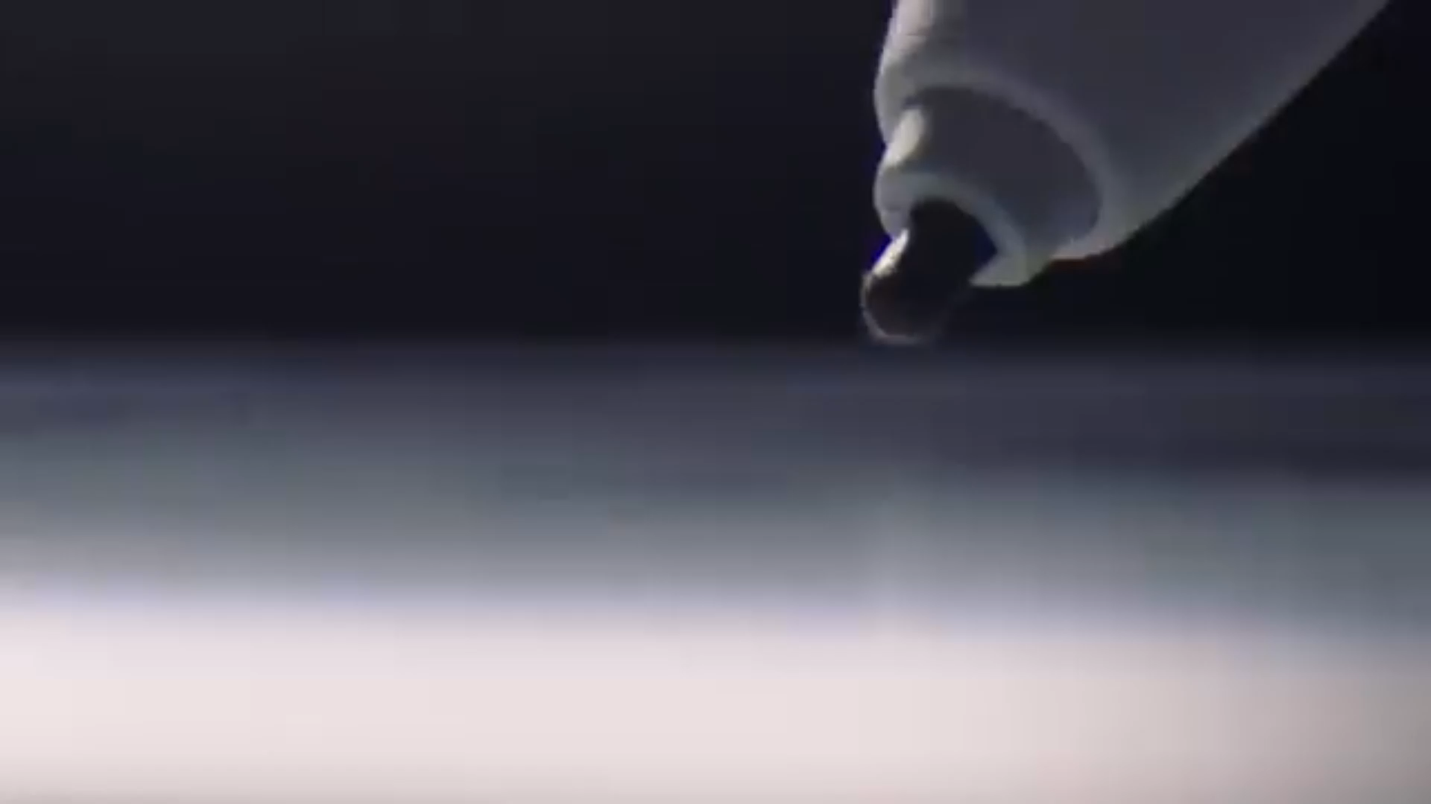
E-Paper
(Continued..)
One good demonstration to the working of E-Paper displays was given by ReMarkable as seen here:

Slide 5
Technologies Used:
E-Paper or E-Ink Displays.
IoT Enabled Edge Microcontrollers. (ESP32 boards with on-board CircuitPython)
[Adafruit HUZZAH32 Feather v2 (on-board ESP32-PICO-MINI-02 controller)]
Web interface (NodeJS)
Main Server (Raspberry Pi 5 Running Debian Bookworm OS)
Database. (to store status and displayed data)
[None at the moment, but SQLite to be implemented soon]
REST API for communication between the parent server and `the Edge devices. (MQTT server and Mini-MQTT clients)
Mosquitto MQTT: A service client to provide interface for MQTT broadcasts, serving as a REST API layer.

Slide 6
Technologies Used:
(Continued..)
Python: Scripts for handling server-side processing and broadcasting. The libraries used are:
Pillow : Image Processing
NumPy : Image bitmap conversion
paho-mqtt : library to broadcast messages on a verified MQTT channel
os : obtaining file paths
sys : obtaining command-line arguments, sent in by the NodeJS triggers
CircuitPython: Firmware by Adafruit systems for running on multi-cored system microcontrollers. Libraries used include
digitalio, displayio, terminalio, adafruit_displayio_sh1107, Mini-mqtt, adafruit_display_text and others

Slide 7










Project Structure:
Server With Database
Web Interface
Controller 1
Display 1
Controller 2
Display 1
User
Controller 3
Display 1

Slide 8
Structure Brief -> User Interface Website
The main user interfacing website is built with NodeJS now, but will be migrated to Svelte during production, for better performance and smoother workflow
Currently, the main User Interface consists mainly of a webpage to upload images and give them an appropriate name. These image files are then uploaded to the main server [Raspberry Pi 5 - running Debian Bookworm]
This is mainly handled by a HTML Form.

Slide 9
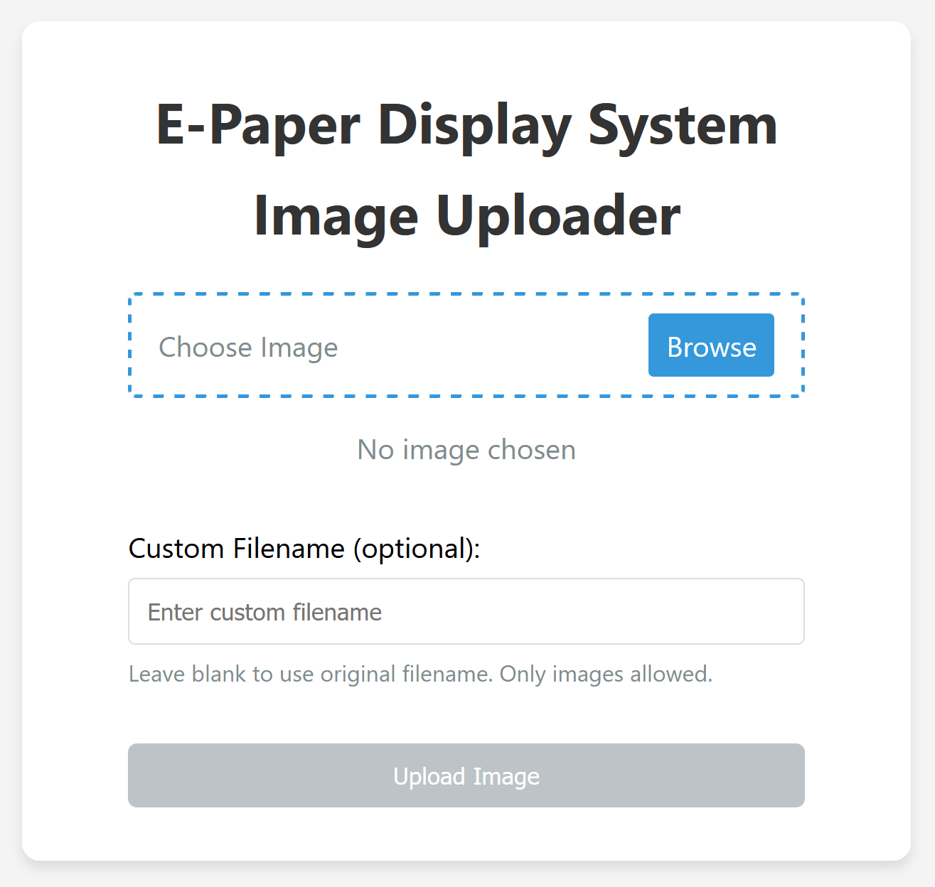
Structure Brief -> User Interface Website

Slide 10
Structure Brief -> Main Server
The main Server is currently a Raspberry Pi 5 Running Debian Bookworm
For the Purpose of this demonstration, I am running a HTTP and an SSH Tunnel via ngrok.
The main server is running 3 services, other than ngrok tunnels:
1. NodeJS Server for the User Interface Website along with a python script to process the images
2. Mosquitto – a server-side client that enables MQTT broadcasts
3. A Python script to detect uploads and send timely MQTT broadcasts to the multiple micro-controllers connected to the server

Slide 11
Structure Brief -> Main Server
NodeJS Server: Consists of a simple http form site that accepts post request on the /post sub-url, which triggers a python script to run – to process the image for displaying on the E-paper display
Mosquitto: A service client that runs on the server machine, creating a WIFI-based channel for broadcasting MQTT protocol messages between all connected clients over multiple channels
Python Scripts: 2 scripts – one triggered by the post form on the NodeJS server to process the image using Pillow and NumPy. The second, to broadcast the image files over MQTT channels
ngrok: a service client to create SSH, HTTP and similar tunnels for remote access and availability

Slide 12
Structure Brief -> Microcontrollers
The Micro-Controllers are ESP32 Microcontrollers
Currently, the microcontroller being used is a Adafruit ESP32 HUZZAH32 Feather V2, a microcontroller by Adafruit Industries, running CircuitPython Firmware, with a script running to receive the MQTT broadcasts from the main server, which contains the files to be displayed.
The files are then converted into displayio (library for creating display-able objects) frames and then sent over to the E-Paper Display

Slide 13
Advantages Over Traditional Methods
The following are the currently analyzed advantages of this system over traditional methods like posters and LED displays:
Consumes almost 95% lesser electricity compared to traditional LED displays, as the displays only need to refresh and consume electricity only when changing the image on display.
Produce far less waste as compared to paper-based billboards.
Highly recyclable as compared to led displays and can recover up to 99% of their materials for reuse
Can also be re-purposed into other appliances at the end of their useful lifetime.

Slide 14
Disadvantages
The following are the disadvantages of using E-Paper Displays
Expensive and complicated to set-up
Lack of manufacturing technologies and production costs
Need an external, minimal source of light as they do not emit light on their own, merely reflect.

Slide 15
Future Scope and Plans
The following are the possible future scopes and plans for this project:
Technological Enhancements:
SvelteKit or FastAPI migration
Replacing bulky feather form factor board with xiao form factor boards
Intelligent Content Management -> Auto format and resize data
LoRaWAN for extended wireless communication
Coloured E-Paper Technology Integration
Enhanced MQTT Architecture -> higher level of encryption and better session handling.

